Slide 1
Selling SEL to Your Staff
NCSCA Conference, November 2022

Slide 2
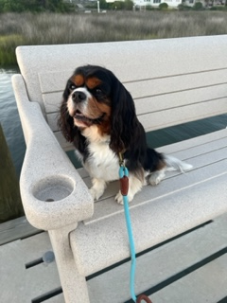
About Me
UNC Chapel Hill- Go Tar Heels!
Horton Middle School (Chatham County) 7 years
Swansboro Middle School (Onslow County) 9 years
Swansboro Elementary- This is my 4th year in elementary school
National Board Certified
Licensed Clinical Mental Health Counselor

Slide 3
About Swansboro Elementary School
Growing School- 500-700 students
Military Community
Rural
Coastal Tourist Town
Swansboro is awesome...come visit!

Slide 4
Why Sell SEL

Slide 5
COVID- This needs no other words
Florence- We missed 8 weeks of school fall 2018
My fifth graders- this is their first normal school year in 4 years!

Slide 6
Counselor Evaluation
Ia
Provides professional development within the school that addresses student needs
Provides input in the selection of professional development for the school staff
IIIc
Provides assistance to school staff as they integrate the North Carolina Guidance Essential Standards into their content areas/disciplines

Slide 7
Different Ways to Organize SEL for Your Staff

Slide 8
Casel Framework
Self-Awareness
Self-Management
Social Awareness
Relationship Skills
Responsible Decision-Making

Slide 9
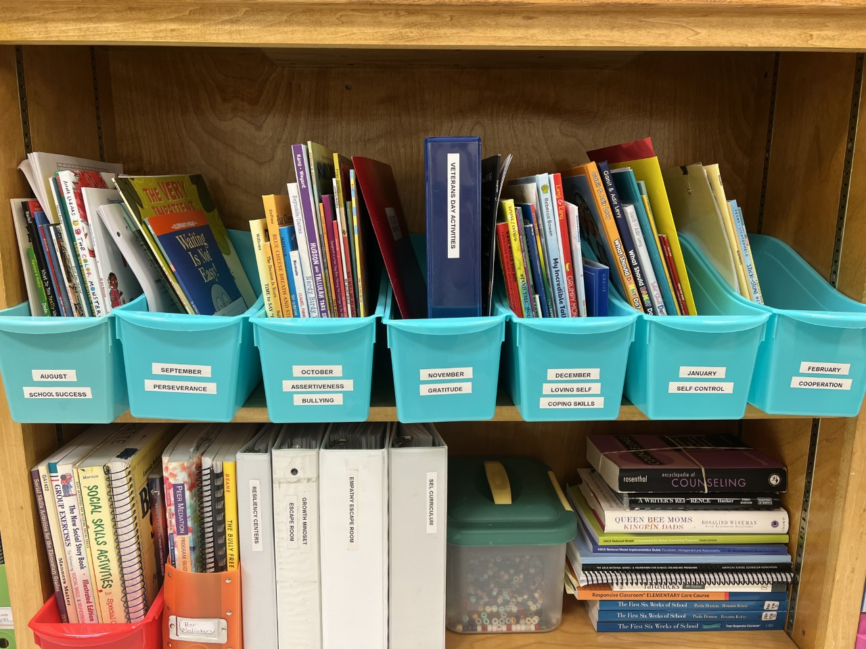
Responsive Classroom- Guiding Principles
Perseverance
Assertiveness
Loving Self/Coping Skills
Self- Control
Cooperation
Attitude/ Growth Mindset
Responsibility
Empathy

Slide 10
Character Traits
Respect
Responsibility
Integrity
Perseverance
Courage
Justice
Self-Discipline

Slide 11
What to Include
Discussion Prompts
Videos
Read Alouds
Group and Independent Practice Activities
K-2 vs 3-5

Slide 12
How to Share With Your Staff

Slide 13
Keep lessons short and easy
Consider once a month or even once a week
Present at Staff Meetings
Follow up with emails, words of encouragement
Do you need data...consider using a platform like SWAY so you can see "views"
Give info in small doses!

Slide 14
Overview of SEL
First Staff Presentation
SWAY

Slide 15
Self-Awareness
Topics to Cover
Emotions
Strengths and Weaknesses
Learning Styles
Confidence
Growth Mindset
SWAY

Slide 16
Self-Management
Topics to Cover
Self-Control
Coping Skills
Perseverance
SWAY

Slide 17
Social Awareness
Topics to Cover
Empathy
Diversity
Perspective Taking
Respect
SWAY

Slide 18
Relationship Skills
Topics to Cover
Communication
Teamwork
Peer Pressure
Friendship
Assertiveness
Cooperation
SWAY

Slide 19
Responsible Decision-Making
Topics to Cover
Decision Making
Problem Solving
Responsibility
SWAY

Slide 20
Ask for Feedback
What format did they like best? (PowerPoint vs List of Activities)
What activities do they like best? (Read Alouds, Independent Practice, Games)
What else do they want to see included?
Do they have a resource or activity I can add and share with whole school?

Slide 21
I'm Home from Conference...What Now

Slide 22
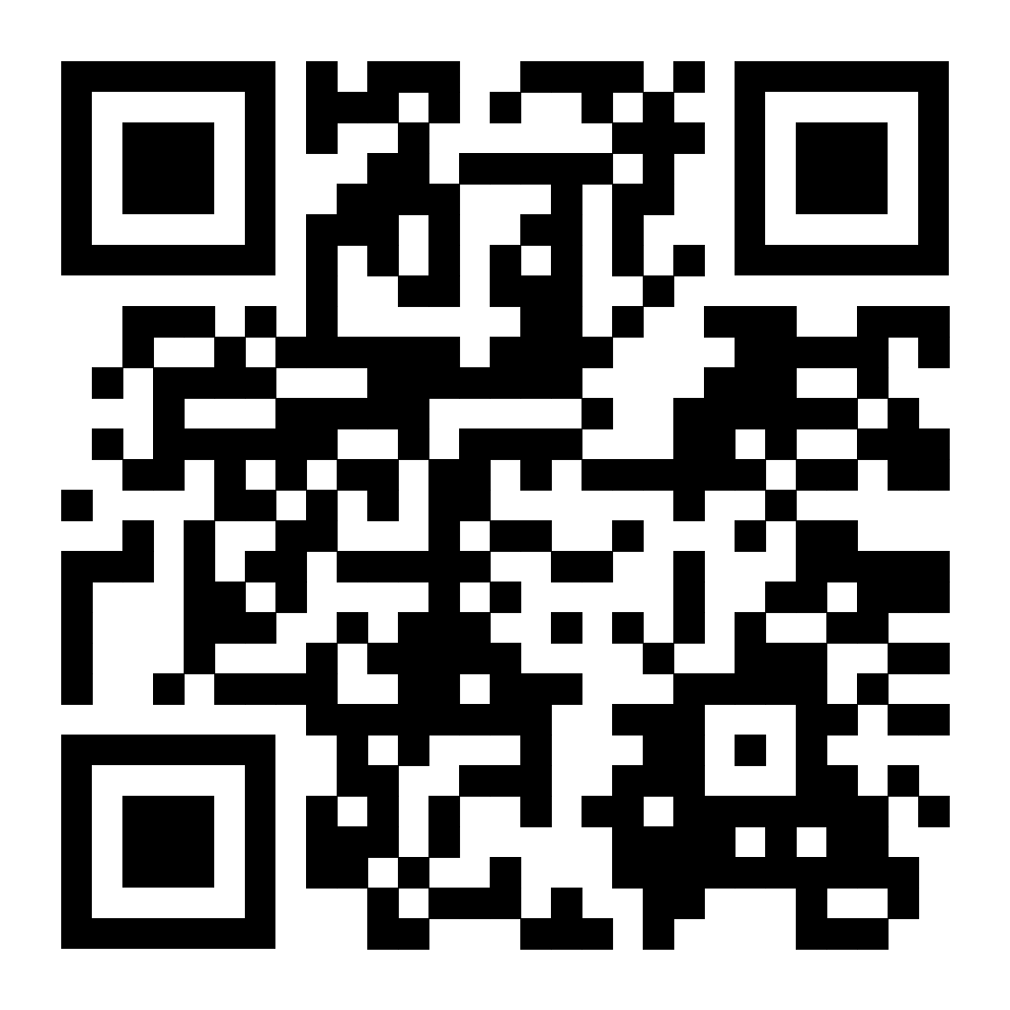
QR Code
Overcoming Obstacles Website
Contact Me Anytime carrie.jackson@onslow.k12.nc.us
Free SEL Resource

Slide 23
Resources from the Group
Harmony
Counselor Keri
Mind Up
Conscious Discipline
Responsive Counselor
Learning for Justice
Character Strong Curriculum
Read Think Ed Program
Signature Practice by CASEL

